Slide 1

KNOWLEDGE INSTITUTE OF TECHNOLOGY, SALEM – 637504
(Autonomous Institution)
MAP
2025
PORTABLE PLANT CUTTER
Batch No.: 4
Club Name : SUSTANABLE ENGINEERING CLUB
Team Members: GURU PRASANNA V , KARTHI VS ,KARTHICK SS ,BRAJEETH G, THIRAGANTH J
Full Affiliation: III Year , Knowledge Institute of Technology. Salem.
Name of the Mentor: KARHICK KN
Presentation Date: 29/07/25

Slide 2
Table of Content
List of Problems through customers / industry defined problems
Selected Final Problem Statement (Tentative through KIOT faculty mentor)
Plan to execute
References if any

Slide 3
List of Problems through customers / industry defined problems
 | Short Summary of Problem Statement | Problem identified through (direct customer, industry, SIH contest, other contest etc.) | Align with SDGs (SDG 1 to SDG17)
Problem Statement 1 | BLADELESS WIND TURBINE | SOLAR CUSTOMER | SDG07
Problem Statement 2 | SMART TECHNOLOGY ANTENNA DTH | DTH CUSTOMER | SDG13
Problem Statement 3 | SMART BUCKET | MARKET ,HOTEL MANAGEMENT | SDG03
Problem Statement 4 | METAL SCRAP COLLECTOR | BLACKSMITH WORKSHOP | SDG09
Problem Statement 5 | PORTABLE PLANT CUTTER | HIGHWAYS MAINTANANCE | SDG07

Slide 4
Selected Final Problem Statement (Tentative)
Problem — Manual plant cutting is labor-intensive, time-consuming, and causes operator fatigue, demanding a mechanized solution.
Solution — A wheeled, motorized cutter using dual DC Motor 775s with rotating blades for efficient and precise trimming.
Power & Mobility — Powered by a 12V 9Ah rechargeable battery and mounted on a wheeled frame for easy portability across fields.
Impact — Reduces human effort, increases productivity, and provides a low-cost alternative for nurseries, farms, and greenhouses.

Slide 5
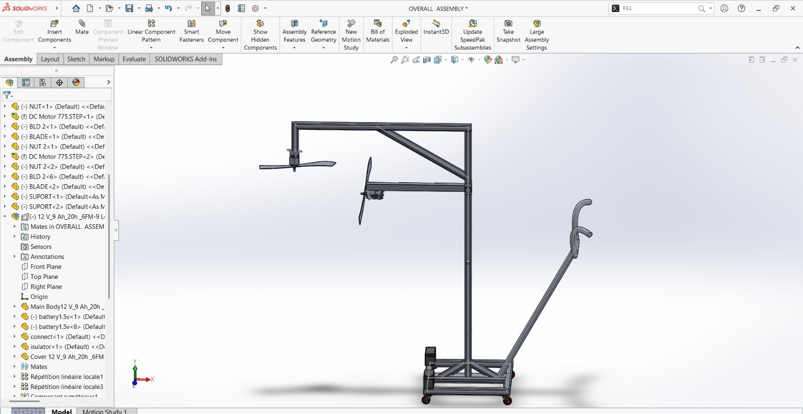
Plan to Execute (Tentative)
Problem Study
Requirement Analysis
Concept Design
Cad model
Design Validation
Prototype Planning
Final Documentation

Slide 6
References
https://youtube.com/shorts/c2C49m-iQOA?si=95VkeJkcGzkkvv4T
https://share.google/VOsKKeFEnlVA1U9Hy
https://share.google/fLWd7LCSw6nKz6Umv
https://share.google/ejCVVsS8FFX1zMhBv
Https://share.google/UklxUwnKaZMUIx4PE

